Slide 1

Analyzing the Impact of Property Characteristics on Real Estate Prices in Bengaluru

Slide 2
Problem Definition
BUSINESS PROBLEM
How do various property characteristics, such as area type, size, location, and amenities, influence real estate prices in Bengaluru?
OBJECTIVE
The primary objective of this study is to gain a comprehensive understanding of how various property characteristics impact real estate prices in Bengaluru.
By conducting thorough research and analysis, the aim is to provide valuable insights for buyers, sellers, and investors in the Bengaluru real estate market.

Slide 3

Research Methods
Our methodology involved rigorous data preprocessing, including handling missing values and outliers to ensure data quality.
Subsequently, we employed various models such as K-Fold Cross-Validation, One-Hot Encoding, and Gridsearchcv.
Using Gridsearchcv, we compared three models - Linear regression, Lasso regression, and Decision tree - to determine the most accurate predictor of real estate prices.

Slide 4
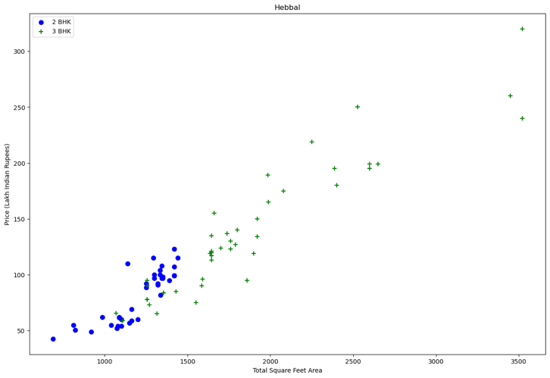
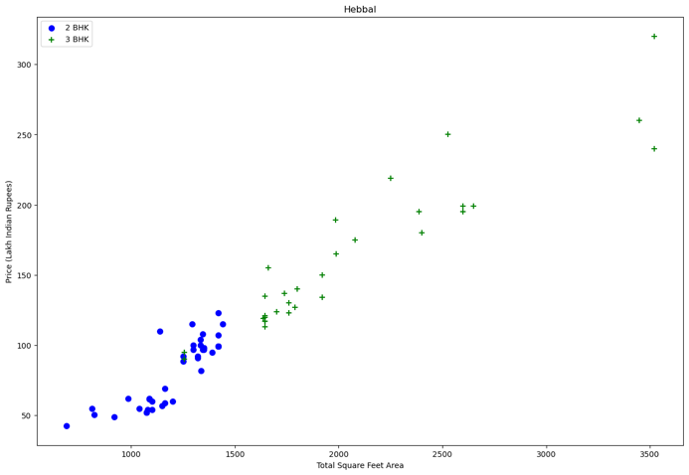
Handling the outliers.
Before outliers removal
After outliers removal

Slide 5
Linear Regression Model Used
We are pursuing with Linear Regression as we are Predicting the price of houses based on features like total square footage, number of bathrooms, and bedrooms.
Linear Regression:
Why: Chosen for its simplicity and ability to model linear relationships, suitable for predicting numerical values like house prices.
Performance: Achieved a high score of 81% on the test data.
Prediction Function:
Created a function to predict house prices based on user-input features like location, square footage, bathrooms, and bedrooms.

Slide 6
Machine Learning Models Applied
One hot Encoding
We utilized one-hot encoding to convert categorical variables into numerical format, enabling our model to interpret them effectively during analysis.
K-Fold Cross-Validation
We employed k-fold cross-validation to validate our model's performance effectively. This technique splits the dataset into k subsets, allowing us to train and test the model multiple times to ensure reliable evaluation.
GridSearchCV :
We employed gridsearchcv to compare three models - linear regression, lasso regression, and decision tree to identify the most accurate model for predicting house prices in our analysis.
Linear Regression
Lasso Regression
Decision Tree

Slide 7
Results & Discussion
Model Performance Overview:
Linear Regression Model: Achieved the highest R² score of 81.9%, indicating that approximately 82% of the variance in Bangalore house prices can be predicted from our features.
Lasso Regression: Achieved an R² score of 68.7% with optimal parameters.
Decision Tree: Scored an R² of 72.2%.
Best Model Selection:
Among the models tested on GridSearchCV, Linear Regression proved to be the most effective for our data, balancing complexity and prediction accuracy.

Slide 8

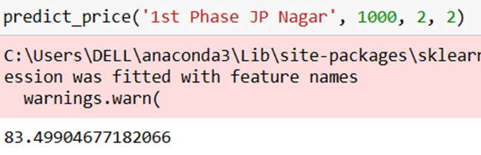
How the Results Answer the Business Problem:
The high R² score of the Linear Regression model (81.9%) indicates a strong ability to predict house prices based on the input features of location, square footage, number of bathrooms, and bedrooms.
This confirms that there is a quantifiable relationship between house characteristics and their market prices in Bangalore.
By using the best performing model (Linear Regression), we can reliably estimate the market price of a house, which answers our primary research question affirmatively.

Slide 9

CONCLUSION & IMPLICATIONS
For Real Estate Stakeholders: The model provides a reliable tool for buyers, sellers, and real estate agents to estimate property values, aiding in more informed decision-making. For Urban Planning and Development: Insights from the model can help in understanding housing price trends, contributing to better urban planning and development strategies. Economic Insights: The predictability of house prices based on certain features could indicate market stability or volatility, offering valuable information for economic forecasting and policy-making.
Implications:
Summary: The Linear Regression model demonstrated the highest predictive accuracy with an R² score of 81.9%, confirming its efficacy in predicting real estate prices in Bangalore, confirming that location, total square footage, number of bathrooms, and bedrooms (BHK) are significant predictors of housing prices. Hence, model like linear regression can effectively handle the prediction if the feature set is properly engineered and outliers are managed.

Slide 10


Recommendations
Expand Geographic Scope: To increase the generalizability of the findings, future research could apply similar models to different cities or regions.
Incorporate Additional Features: Including more granular data such as neighbourhood crime rates, school district ratings, and public transport accessibility could provide deeper insights.
Integration of Macro-Economic Factors: Include macro-economic indicators such as interest rates, employment rates, GDP growth, and inflation as predictors to see how broader economic conditions influence real estate markets.

Slide 11

Thankyou!

